Slide 1
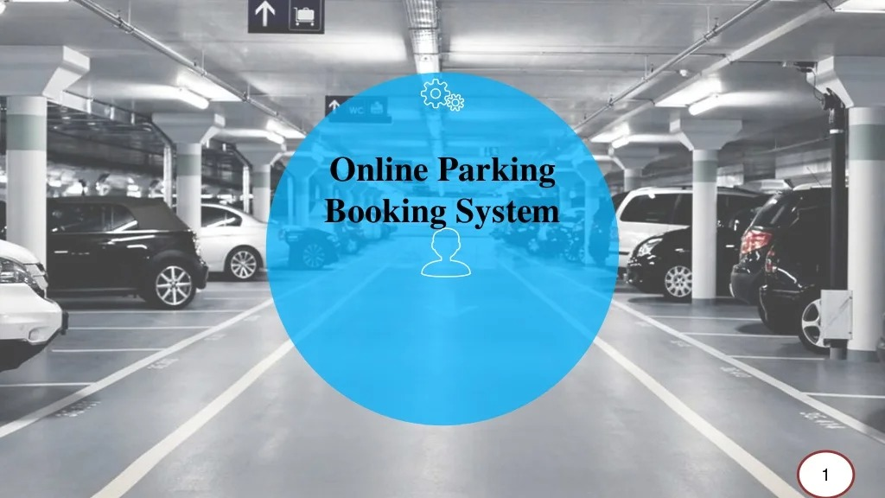
PARKEASE
READY TO RESERVE SPACE REMOTLY TECHTITANS

Slide 2
PROBLEM STATEMENT
Develop an application that transforms the traditional parking experience by enabling users to reserve parking spaces remotely. In a parallel to metro ticketing applications, this innovative solution aims to streamline and modernize the process of securing parking spaces, eliminating the need for users to wait in queues at physical parking locations .Where it reduces number of employees and save time.

Slide 3
KEY FEATURES
REPORT!

Slide 4
KEY FEATURES
INTERFACE DESIGN
QUEUE REDUCTION
Simple and intuitive layout Responsive design for various devices Visual indicators for real-time space availability User profiles for personalized experiences.
Instant reservations to eliminate physical queues Time slot reservations to manage congestion during peak hours

Slide 5
KEY FEATURES
NAVIGATE TO RESERVE SPACE
MOBILE PAYMENT INTEGRATION
REAL TIME SPACE AVAILABILITY
Integration of geolocation services Visual maps for easy navigation within parking lot
Continuous updates on space availability Filtering options for user preferences Waitlist feature for popular spaces
Secure payment gateway Multiple payment options Instant confirmation of transactions and reservations

Slide 6



DOMAIN=WEBDEVELOPMENT
HTML
CSS
JAVASCRIPT

Slide 7
OVERVIEW
The proposed project is an Online parking booking system that provides customers an easy way of reserving a parking space online. It overcomes the problem of finding a parking space in commercial areas that unnecessary consumes time. Hence this project offers a web based reservation system where users can view various parking areas and select the space to view whether space is available or not. If the booking space is available then he can book it for specific time slot. Users can even make payment online.
The project can be implemented in commercial areas for employee parking.
It can be utilized by companies and organizations (hospitals, schools, colleges) to automate their parking system.
The system can also be used in public places for public parking like in malls, station, and so on.

Slide 8
THANK YOU
TECHTITANS
CHANDRESHAKER .K.R
ABHISHEK .S. P
ARUN BALAJEE. A. P
SHREE RAM. A. N

